Slide 1

DEV306
LINQ (Language Integrated Query)
Frank Maar
frank.maar@microsoft.com
Technologieberater Visual Studio
Microsoft Deutschland GmbH

Slide 2
Problem:
Data != Objects

Slide 3
Customer Requirements
Database applications need to be able to evolve from the current model. We can’t force them to choose between throwing away code and using the great new stuff.
  ODBC, DAO, RDO, OLEDB, ADO, ADO.NET
  ISV’s always end up building boats over us
Data is everywhere and fundamentally structured.
  Understanding that structure is takes time from coding
  Programming teams want to work in their domain area
    Financial, Oil, Retail – different understanding of “Customer”
  Intermediate storage for in-memory, embedded caches
  Programmers want those caches close to their code

Slide 4
EDB/IMDB Product Pressure
SQL Server
Enterprise Edition
SQL Server
Express
Deployment Complexity
EDB / IMDB
PRODUCT GAP
PRESSURE
Dataset
Data Structure Process Application Server Cluster Grid
Notes:
If you look at the spectrum of embedded structures to support data programming starting with data structures and progressing in complexity to servers, clusters and someday grids each product fits a specific space and brings with it a cooresponding level of deployment complexity. Today there is customer pressure both on dataset from below to add scalability, persistence, and generalized query capabilities, while we have pressure to push the SQL Server Express SKU down to ease deployment especially with rich client or mid-tier applications.

Slide 5
The LINQ Project
C# 3.0
VB 9.0
Others…
.NET Language Integrated Query
LINQ to
Objects
LINQ to
DataSets
LINQ to
SQL
LINQ to
Entities
LINQ to
XML
<book>
<title/>
<author/>
<year/>
<price/>
</book>
Objects
Relational
XML

Slide 6
Project Linq
VB & C # language extensions
  Enable creation of higher-order APIs
Base query operators
  API for querying arbitrary data structures
DLinq
  Query enabled Object-Relational API
XLinq
  Query enabled, modern, consistent XML API

Slide 7
LINQ
Restriction | Where
Projection | Select, SelectMany
Ordering | OrderBy, ThenBy
Grouping | GroupBy
Joins | Join, GroupJoin
Quantifiers | Any, All
Partitioning | Take, Skip, TakeWhile, SkipWhile
Sets | Distinct, Union, Intersect, Except
Elements | First, Last, Single, ElementAt
Aggregation | Count, Sum, Min, Max, Average
Conversion | ToArray, ToList, ToDictionary
Casting | OfType<T>, Cast<T>

Slide 8
LINQ to SQL
Accessing data today
Queries in quotes
SqlConnection c = new SqlConnection(…);
c.Open();
SqlCommand cmd = new SqlCommand(
@"SELECT c.Name, c.Phone
FROM Customers c
WHERE c.City = @p0");
cmd.Parameters.AddWithValue("@p0", "London“);
DataReader dr = c.Execute(cmd);
while (dr.Read()) {
string name = dr.GetString(0);
string phone = dr.GetString(1);
DateTime date = dr.GetDateTime(2);
}
dr.Close();
Loosely bound arguments
Loosely typed result sets
No compile time checks

Slide 9
LINQ to SQL
Accessing data with LINQ
Classes describe data
public class Customer { … }
public class Northwind : DataContext
{
public Table<Customer> Customers;
…
}
Tables are like collections
Strongly typed connections
Northwind db = new Northwind(…);
var contacts =
from c in db.Customers
where c.City == "London"
select new { c.Name, c.Phone };
Integrated query syntax
Strongly typed results

Slide 10
LINQ to SQL
Language integrated data access
  Maps tables and rows to classes and objects
  Builds on ADO.NET and .NET Transactions
Mapping
  Encoded in attributes or external XML file
  Relationships map to properties
Persistence
  Automatic change tracking
  Updates through SQL or stored procedures

Slide 11
LINQ to SQL Mapping
Database
DataContext
Table
Class
View
Class
Column
Field / Property
Relationship
Field / Property
Stored Procedure
Method

Slide 12
LINQ to SQL Architecture
from c in db.Customers
where c.City == "London"
select c.CompanyName
Application
db.Customers.Add(c1);
c2.City = "Barcelona";
db.Customers.Remove(c3);
LINQ Query
Objects
SubmitChanges()
LINQ to SQL
SQL Query
Rows
DML or SProcs
SELECT CompanyName
FROM Cust
WHERE City = 'London'
INSERT INTO Cust …
UPDATE Cust …
DELETE FROM Cust …
SQL Server

Slide 13
Key Points
Flexible mapping
  “Classes first” or “data first”, attributes or mapping file
DataContext
  Strongly typed database connection
Entity classes
  Identity mapping and change tracking
Relationships
  One-to-one, one-to-many

Slide 14
Key Points
Change tracking
  Updates through dynamic SQL DML or stored procedures
Optimistic concurrency
Stored procedures
  Represented as methods on DataContext
Dynamic queries
  Expression trees and dynamic parser

Slide 15
Oracle
Oracle driver from Oracle and DataDirect
The DataDirect driver is expected to be available within a couple months of the LINQ release
We expect that the Oracle driver will be more along the lines of 6-12 months after the release

Slide 16
Third-party languages
Delphi
  http://blogs.borland.com/dcc/archive/2005/09/15/21195.aspx
Phalanger 2.0
  PHP compiler for .NET, LINQ syntax per "PHP/CLR - Extensions to the PHP Language in Phalanger 2.0“
  http://www.codeplex.com/Phalanger/Wiki/View.aspx?title=Documentation)
Nemerle
  macros being developed per
  http://thread.gmane.org/gmane.comp.lang.nemerle.devel/1257

Slide 17
LINQ to XML
Programming XML today
Imperative
model
XmlDocument doc = new XmlDocument();
XmlElement contacts = doc.CreateElement("contacts");
foreach (Customer c in customers)
if (c.Country == "USA") {
XmlElement e = doc.CreateElement("contact");
XmlElement name = doc.CreateElement("name");
name.InnerText = c.CompanyName;
e.AppendChild(name);
XmlElement phone = doc.CreateElement("phone");
phone.InnerText = c.Phone;
e.AppendChild(phone);
contacts.AppendChild(e);
}
doc.AppendChild(contacts);
Document
centric
No integrated queries
Memory intensive
<contacts>
<contact>
<name>Great Lakes Food</name>
<phone>(503) 555-7123</phone>
</contact>
…
</contacts>

Slide 18
LINQ to XML
Programming XML with LINQ
Declarative model
XElement contacts = new XElement("contacts",
from c in customers
where c.Country == "USA"
select new XElement("contact",
new XElement("name", c.CompanyName),
new XElement("phone", c.Phone)
)
);
Element
centric
Integrated queries
Smaller and faster

Slide 19
Key Points
Identity mapping
  Maps primary keys onto object references
Relationships
  Pre-defined joins, lazy or eager fetching
Ad hoc joins
  Inner joins and grouped joins
Deferred execution
  Cost-free query composition

Slide 20
ADO.NET V3 in Orcas
Language integrated data access
  Maps tables and rows to classes and objects
  Extends ADO.NET - provider, dataset, mapping, object layers
  Works well with .NET Transactions
Mapping
  Declarative approach promoting reuse, evolution
  Relationships map to properties
  Supports containment vs. association
  Starting point for metadata infrastructure
Consistent update and query views for mapping
  Persistence and identity management
  Automatic change tracking
  Updates through SQL or stored procs
Notes:
*

Slide 21
Deep Technical Foundation
Based on 30 years of product and research experience
  Proven - view maintenance technology
  Scales - multiplicative complexity of mapping
  Bidirectional views – update/query symmetry
Grounded on relational technology
Performance and Scalability
  Must live up to SQL Server’s birthright and customer expectation
  Avoid Hidden Cliffs in Query Processing
  Must include real-world enterprise software scenarios

Slide 22
Sample: Simple Query
Dim primes = {2, 5, 7, 11, 13, 15}
Dim primesUnder9 = Select p From p In primes Where p < 9
‘ To display the results
For Each num In PrimesUnder9
Console.Writeline(“Num: “ & num)
Next
Stop

Slide 23
Sample: Interesting Query
‘ To query
Dim tasks = Select proc.ProcessName, proc.ID _
From proc In System.Diagnostics.Process.GetProcesses()_
Where proc.Threads.Count > 6
‘ To display
For each task In Tasks
Console.Writeline(“Name : “ & task.ProcessName & _
“ ID: “ & task.ID)
Next
Stop

Slide 24

LINQ to SQL
Select

Slide 25
LINQ to SQL
Update and Delete

Slide 26
Challenges Around LINQ
Performance of brute-force query execution across moderate-size in-memory collections can be bad very quickly
  Brute-force Joins are implemented as nested loops – O(size(T1)*size(T2)). Performance slow-down noticeable even in collections containing a few hundred rows.
  There are well know execution strategies O(size(T1)+size(T2)) → May need a light weight QP to exploit

Slide 27
Empfehlungen
Visual Studio 2008 (Orcas) Beta 2 VPC herunterladen und mit LINQ vertraut machen
Bestehende Anwendungen so lassen
Neue Anwendungen ab 2.Quartal 2008 LINQ nutzen
  Selbst entwickeltes objektrelationales Mapping entfällt

Slide 28
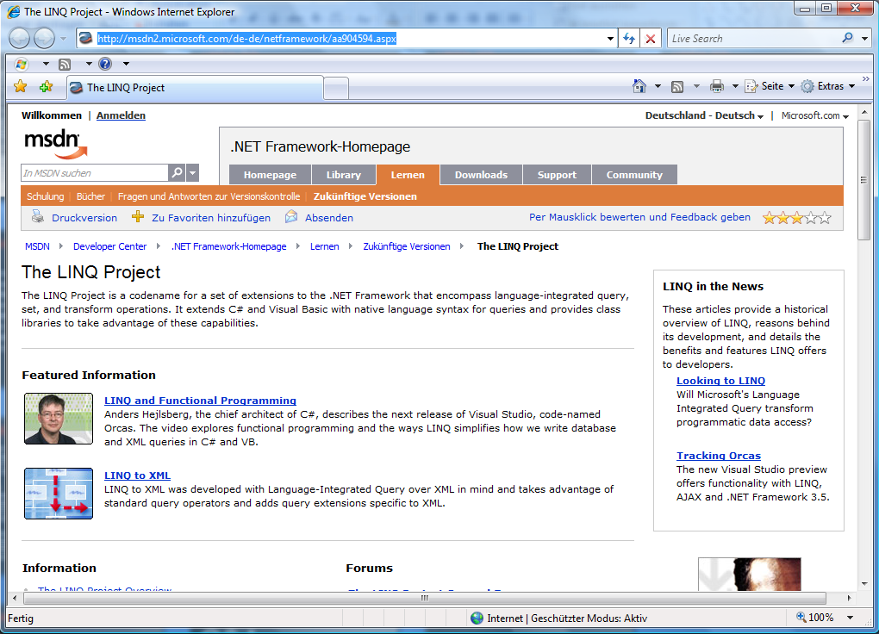


Slide 29


Slide 30
© 2006 Microsoft Corporation. All rights reserved.
This presentation is for informational purposes only.
MICROSOFT MAKES NO WARRANTIES, EXPRESS OR IMPLIED, IN THIS SUMMARY.

